Slide 1
Recursion, pt. 1
The Foundations
06-30-2014

Slide 2
What is Recursion?
Recursion is the idea of solving a problem in terms of itself.
For some problems, it may not possible to find a direct solution.
Instead, the problem is typically broken down, progressively, into simpler and simpler versions of itself for evaluation.

Slide 3
What is Recursion?
One famous problem which is solved in a recursive manner: the factorial.
n! = 1 for n = 0, n =1…
n! = n * (n-1)!, n > 1.
Note that aside from the n=0, n=1 cases, the factorial’s solution is stated in terms of a reduced form of itself.

Slide 4
What is Recursion?
As long as n is a non-negative integer, n! will eventually reach a reduced form for which there is an exact solution.
5! = 5 * 4! = 5 * 4 * 3! = … = 5 * 4 * 3 * 2 * 1

Slide 5
What is Recursion?
From this point, the solution for the reduced problem will be used to determine the exact solution.
5 * 4 * 3 * 2 * 1 = 5 * 4 * 3 * 2 = 5 * 4 * 6 = 5 * 24 = 120.

Slide 6
Recursion
Thus, the main idea of recursion is to reduce a complex problem to a combination of operations upon its simplest form.
This “simplest form” has a well-established, exact solution.

Slide 7
What is Recursion?
As a result of how recursion works, it ends up being subject to a number of jokes:
“In order to understand recursion, you must understand recursion.”
Or, “recursion (n): See recursion.”

Slide 8
A Mathematical Look
Recursion is actually quite similar to a certain fairly well-known mathematical proof technique: induction.

Slide 9
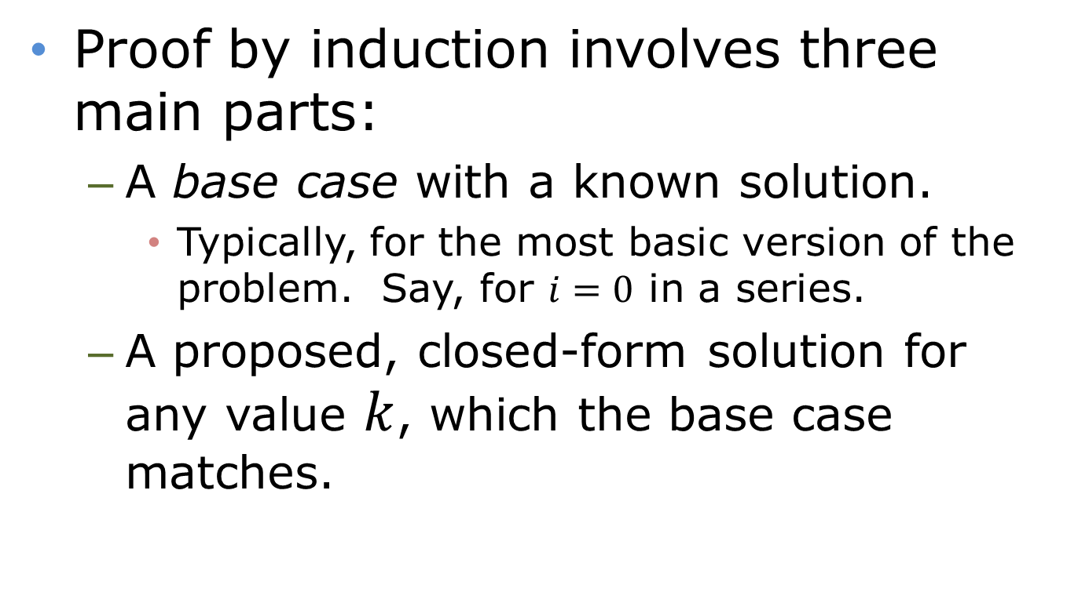
A Mathematical Look
Proof by induction involves three main parts:
A base case with a known solution.
Typically, for the most basic version of the problem. Say, for $i=0$ in a series.
A proposed, closed-form solution for any value $k$, which the base case matches.

Slide 10
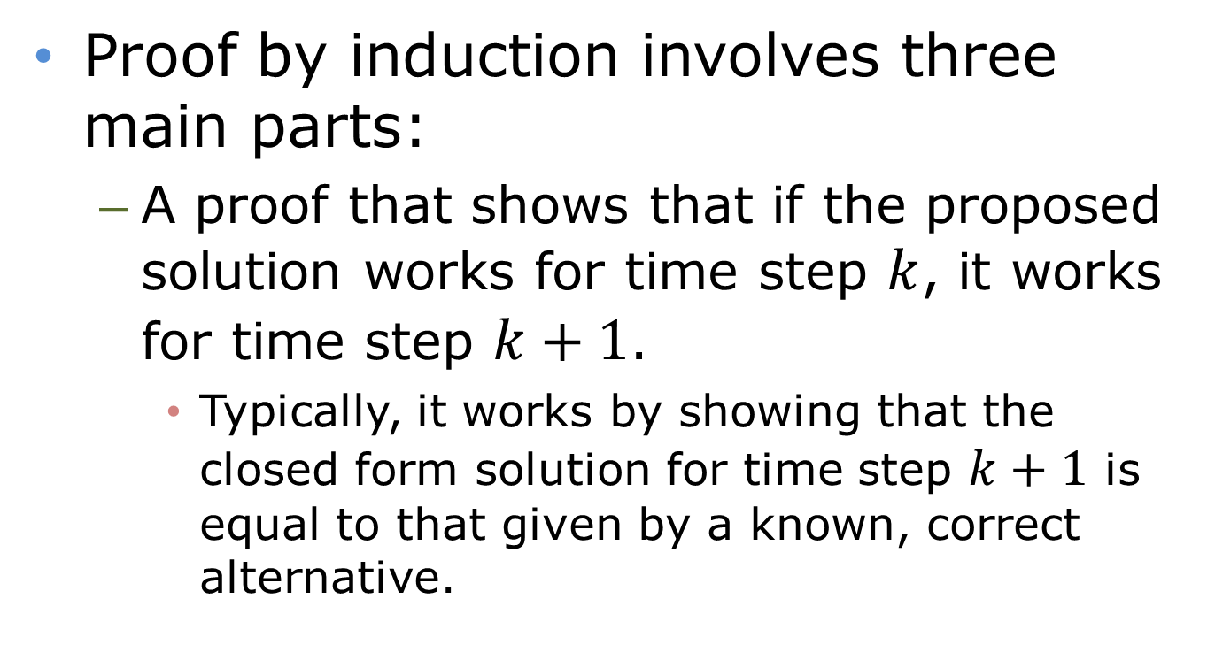
A Mathematical Look
Proof by induction involves three main parts:
A proof that shows that if the proposed solution works for time step $k$, it works for time step $k+1$.
Typically, it works by showing that the closed form solution for time step $k+1$ is equal to that given by a known, correct alternative.

Slide 11
A Mathematical Look
The main idea behind how induction works is the same as that for recursion.
The process is merely inverted: the way that induction proves something is how recursion will actually produce its solution.
While this may be inefficient for problems with a closed-form solution, there are other problems which have no closed form.

Slide 12
The Basic Process
There are two main elements to a recursive solution:
The base case: the form (or forms) of the problem for which an exact solution is provided.
The recursive step: the reduction of one version the problem to a simpler form.

Slide 13
The Basic Process
Note that if we progressively reduce the problem, one step at a time, we’ll eventually hit the base case.
From there, we take that solution and modify it as necessary on the way back up to yield the true solution.

Slide 14
The Basic Process
There are thus these two main elements to a recursive solution of the factorial method:
The base case: 0! and 1!
The recursive step: n! = n * (n-1)!
Note that the “n *” will be applied after the base case is reached.
(n-1)! is the reduced form of the problem.

Slide 15
Coding Recursion
As we’ve already seen, programming languages incorporate the idea of function calls.
This allows us to reuse code in multiple locations within a program.
Is there any reason that a function shouldn’t be able to reuse itself?

Slide 16
Coding Recursion
int factorial(int n)
{
if(n == 0 || n == 1)
return 1;
else return n * factorial(n-1);
}

Slide 17
Coding Recursion
Potential problem: how can the program keep track of its state?
There will multiple versions of “n” over the different calls of the factorial function.
The answer: stacks!
The stack is a data structure we haven’t yet seen, but may examine in brief later in the course.

Slide 18
Coding Recursion
int factorial(int n)
{
if(n == 0 || n == 1)
return 1;
else return n * factorial(n-1);
}
Each individual method call within a recursive process can be called a frame.

Slide 19
Coding Recursion
int factorial(int n)
{
if(n == 0 || n == 1)
return 1;
else return n * factorial(n-1);
}
We’ll use this to denote each frame of this method’s execution.
Let’s try n = 5.
n:

Slide 20
Coding Recursion
int factorial(int n)
{
if(n == 0 || n == 1)
return 1;
else return n * factorial(n-1);
}
n:
2
n:
3
n:
4
Result:
n:
1
5

Slide 21
Coding Recursion
int factorial(int n)
{
if(n == 0 || n == 1)
return 1;
else return n * factorial(n-1);
}
n:
2
n:
3
n:
4
Result:
Result:
n:
1
2
5

Slide 22
Coding Recursion
int factorial(int n)
{
if(n == 0 || n == 1)
return 1;
else return n * factorial(n-1);
}
n:
3
n:
4
Result:
Result:
n:
2
6
5

Slide 23
Coding Recursion
int factorial(int n)
{
if(n == 0 || n == 1)
return 1;
else return n * factorial(n-1);
}
n:
4
Result:
Result:
n:
6
24
5

Slide 24
Coding Recursion
int factorial(int n)
{
if(n == 0 || n == 1)
return 1;
else return n * factorial(n-1);
}
Result:
Result:
n:
24
120
5

Slide 25
Coding Recursion
Notice how recursion looks in code – we have a function that calls itself.
In essence, we assume that we already have a function that already does most of the work needed, aside from one small manipulation.
The trick is that this “already there” function is actually the function we’re writing.

Slide 26
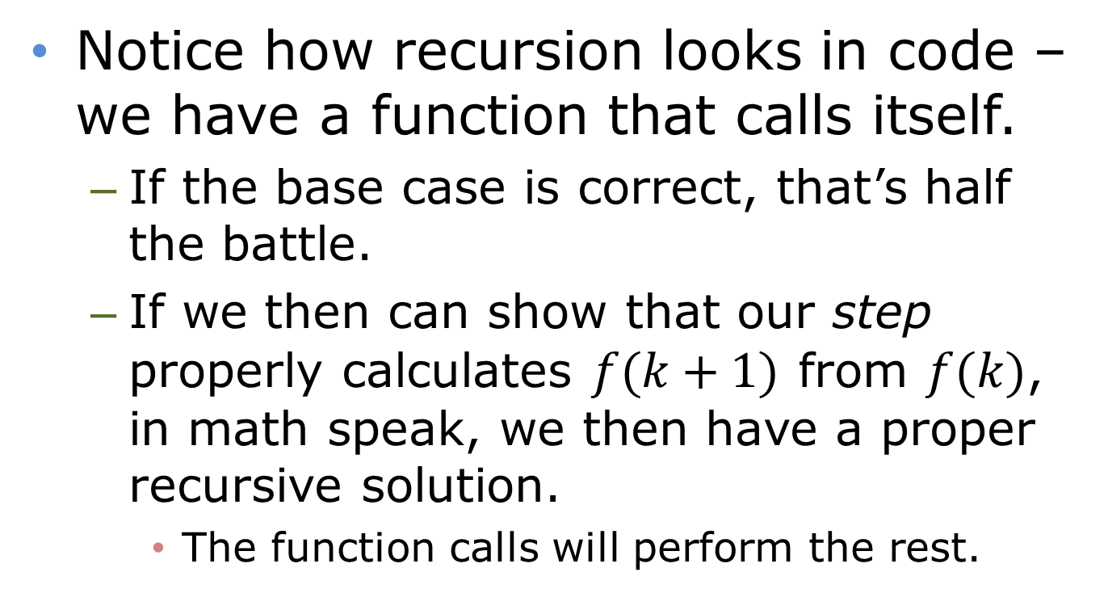
Coding Recursion
Notice how recursion looks in code – we have a function that calls itself.
If the base case is correct, that’s half the battle.
If we then can show that our step properly calculates $f(k+1)$ from $f(k)$, in math speak, we then have a proper recursive solution.
The function calls will perform the rest.

Slide 27
Recursion - Fibonacci
Let’s examine how this would work for another classic recursive problem.
The Fibonacci sequence: Fib(0) = 1 Fib(1) = 1 Fib(n) = Fib(n-2) + Fib(n-1)
How can we code this?
What parts are the base case?
What parts are the recursive step?

Slide 28
Recursion - Fibonacci
int fibonacci(int n)
{
if(n == 0 || n == 1)
return 1;
else
return fibonacci(n-2) + fibonacci(n-1);
}

Slide 29
Recursion - Fibonacci
int fibonacci(int n)
{
if(n == 0 || n == 1)
return 1;
else
A: return fibonacci(n-2) +
B: fibonacci(n-1);
}
We’ll use the below graphics to aid our analysis of this method.
res:
n: pos: part:

Slide 30
Recursion - Fibonacci
if(n == 0 || n == 1)
return 1;
else
A: return fibonacci(n-2) +
B: fibonacci(n-1);
n: pos: part:
3
A
---
res:
n: pos: part:
1
5
A
---

Slide 31
Recursion - Fibonacci
if(n == 0 || n == 1)
return 1;
else
A: return fibonacci(n-2) +
B: fibonacci(n-1);
n: pos: part:
2
A
---
n: pos: part:
3
B
1
res:
n: pos: part:
1
5
A
---

Slide 32
Recursion - Fibonacci
if(n == 0 || n == 1)
return 1;
else
A: return fibonacci(n-2) +
B: fibonacci(n-1);
n: pos: part:
2
B
1
n: pos: part:
3
B
1
res:
n: pos: part:
1
5
A
---

Slide 33
Recursion - Fibonacci
if(n == 0 || n == 1)
return 1;
else
A: return fibonacci(n-2) +
B: fibonacci(n-1);
n: pos: part:
3
B
1
res:
n: pos: part:
2
5
A
---

Slide 34
Recursion - Fibonacci
if(n == 0 || n == 1)
return 1;
else
A: return fibonacci(n-2) +
B: fibonacci(n-1);
res:
n: pos: part:
3
5
A
---

Slide 35
Recursion - Fibonacci
if(n == 0 || n == 1)
return 1;
else
A: return fibonacci(n-2) +
B: fibonacci(n-1);
n: pos: part:
2
A
---
n: pos: part:
4
A
---
res:
n: pos: part:
…
5
B
3

Slide 36
Recursion - Fibonacci
Didn’t we already get an answer for n = 2?
Yep. So I’ll save us some time.
if(n == 0 || n == 1)
return 1;
else
A: return fibonacci(n-2) +
B: fibonacci(n-1);
n: pos: part:
2
A
---
n: pos: part:
4
A
---
res:
n: pos: part:
…
5
B
3

Slide 37
Recursion - Fibonacci
if(n == 0 || n == 1)
return 1;
else
A: return fibonacci(n-2) +
B: fibonacci(n-1);
n: pos: part:
4
A
---
res:
n: pos: part:
2
5
B
3

Slide 38
Recursion - Fibonacci
Didn’t we already get an answer for n = 3?
Yep. So I’ll save us some time.
if(n == 0 || n == 1)
return 1;
else
A: return fibonacci(n-2) +
B: fibonacci(n-1);
n: pos: part:
3
A
---
n: pos: part:
4
B
2
n: pos: part:
5
B
3

Slide 39
Recursion - Fibonacci
Didn’t we already get an answer for n = 3?
Yep. So I’ll save us some time.
if(n == 0 || n == 1)
return 1;
else
A: return fibonacci(n-2) +
B: fibonacci(n-1);
n: pos: part:
4
B
2
res:
n: pos: part:
3
5
B
3

Slide 40
Recursion - Fibonacci
if(n == 0 || n == 1)
return 1;
else
A: return fibonacci(n-2) +
B: fibonacci(n-1);
res:
n: pos: part:
5
5
B
3

Slide 41
Recursion - Fibonacci
if(n == 0 || n == 1)
return 1;
else
A: return fibonacci(n-2) +
B: fibonacci(n-1);
res:
8

Slide 42
Recursion - Fibonacci
Can this be done more efficiently?
You betcha! First off, note that we had had to recalculate some of the intermediate answers.
What if we could have saved those answers?
It’s possible, and the corresponding technique is called dynamic programming.
We’ll not worry about that for now.

Slide 43
Fibonacci
Can this be done more efficiently?
Fun fact for the Fibonacci sequence: it actually has a closed-form solution.
It doesn’t need iteration or recursion!
F(n) = $\frac{{\left(\frac{1+\sqrt{5}}{2}\right)}^{n} − { \left(\frac{1−\sqrt{5}}{2}\right)}^{n}}{\sqrt{5}}$.
$\left(\frac{1+\sqrt{5}}{2}\right)$ is the golden ratio.
F(0) = 0, F(1) = 1 for this version.

